Slide 1
Sport Connect
Ultimate hub for Sports enthusiasts

Slide 2
Overview
Sport Connect aims to provide a platform for sports enthusiasts to connect with each other, share posts, and organize game invitations. A centralized hub for sports-related interactions and aims to enhance user engagement and community building within the sports domain.

Slide 3
Background
Current Problems
The current state lacks a dedicated platform for sports enthusiasts to connect and organize events effectively. This leads to fragmented interactions and missed opportunities for community engagement.

Slide 4
Background
Industry & Stakeholders:
Social Media & Sports Domians
Sports Enthusiasts
sports event organisers
community managers
Advertisers and sponsors

Slide 5
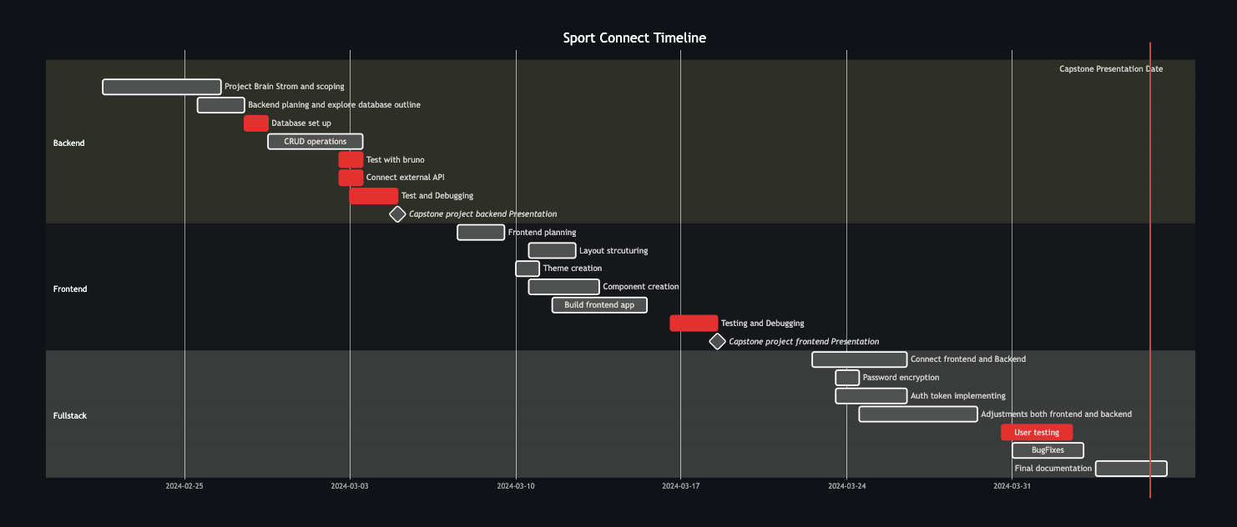
TimeLine

Slide 6
Tech stack
FRONTEND
BACKEND
Nodejs
Express
DATABASE
JavaScript
Vite-React
Material-UI
MongoDB

Slide 7
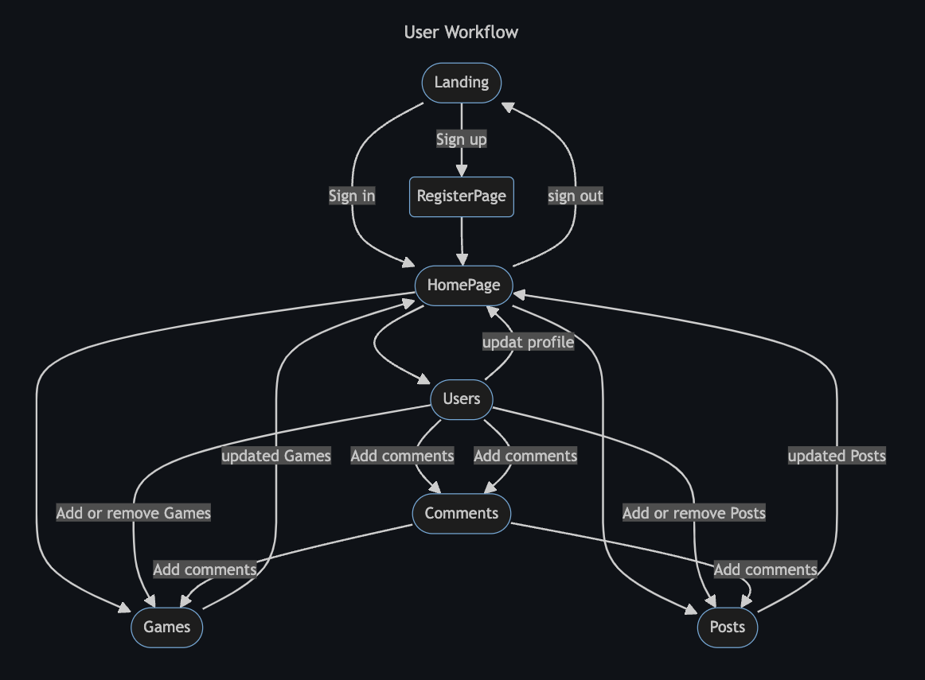
FLOWCHART

Slide 8
LIVE DEMO

Slide 9
GOING FORWARD
Add more social function
Add location function (Google Map)
Connect with external API (NBA, MetService)
Search Function

Slide 10
THANK YOU

